Slide 1
Asset Management
Presented by:
Barbara J. Romero, Bureau Chief
Elizabeth Chavez, Coordinator
Ernest Saavedra, Coordinator

Slide 2
What is Asset Management?​
Maintaining the desired level of service at the lowest life cycle cost to the owner. Allows the owner decision making over the best way to spend the limited funds to achieve the highest impact of the asset. The process should provide a means on how to operate, maintain, repair, rehabilitate and replace the asset based on facts and data collected thru your inventory review process. ​
​
Asset Management is driven by 5 core components in order to achieve maximum useful life of the asset. ​
* Remember you are required to maintain all assets purchased with Capital Outlay Funding

Slide 3
5 Core Components
Current State of the Asset​
Level of Service​
Criticality​
Life Cycle Costing​
Funding

Slide 4
Current State of the Asset
This component is the physical process that you make the determine on the following
What you own
Where it is located
What is the condition of the asset
What is the useful remaining life
What is the replacement value
Gather all the data on each asset, use the existing inventory listings provided by ALTSD or one created in-house. This should be conducted periodically and kept up to date. Use identification numbers that are unique to the types of assets and locations.

Slide 5
Level of Service​
This component will help you with goal setting​
Determine what you want your assets to provide​
Use the SMART (specific, measurable, attainable, realistic, and time bound)​

Slide 6
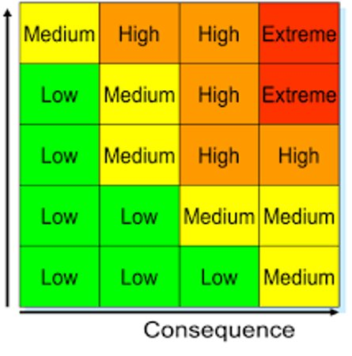
Criticality
This component helps you determine which assets are more critical to the operation or delivery of a service. Ask yourself the following for each asset.​
What is the probability that the asset could fail​
What are the consequences if the asset fails​
After asking and answering the 2 questions you can determine which asset is more critical to the operation or delivery of a service

Slide 7
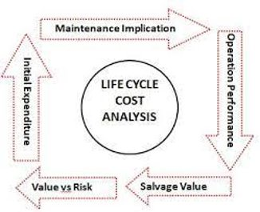
Life cycle Costing​
This component will assist the owners to decide on how they will operate and maintain the asset. ​
When to continue to repair or rehabilitate or replace​
Should the owner include more operating and maintenance ​
When you choose postpone maintenance due to budget short falls it is called deferred maintenance. That means that there could potentially be extensive long-term costs, reduction in asset efficiency, complete failure, safety or health risks, potential for citations from regulatory agencies, issues with that asset can escalate, downtime, emergency repairs that could be more costly. ​
Did you know that deferring maintenance could compound costs at approximately 7% more per year?

Slide 8
Funding $$$
This component will assist you in determining the amount needed for short term or continuous operation.​
Determine the sources and amounts needed​
Continued communication to council or commissions on budget needs to operational and maintenance costs ​
*Capital outlay funds cannot be used for maintenance costs (indirect cost)

